Slide 1



NETWORK SECURITY
& FortiGate
INTEGRATION
ASMAA HAZEM ALI
MARIAM YASSER MATTAR
AHMED SHAABAN
ABDELRAHMAN MOHAMED

Slide 2
AGENDA
•CYBERSECURITY CONCEPTS
•OWASP TOP 10 (2021)
•NETWORK ATTACK TYPES
•FORTIGATE BASIC CONFIGURATION
•ADVANCED FORTIGATE FEATURES (NAT, SSL, WEB FILTER, IPS)
•FINAL TESTING & CONCLUSION

Slide 3
CYBERSECURITY FUNDAMENTALS
PROTECTION OF SYSTEMS, NETWORKS, AND DATA.
CYBER THREATS: HACKERS, INSIDER THREATS, STATE-SPONSORED ATTACKS.
VULNERABILITIES: FLAWS IN CODE, MISCONFIGURATIONS, HUMAN ERROR.
VULNERABILITY SCANNING: FINDS WEAK SPOTS BEFORE ATTACKERS DO.

Slide 4
OWASP TOP 10 (2021)
1. BROKEN ACCESS CONTROL
2. CRYPTOGRAPHIC FAILURES
3. INJECTION
4. INSECURE DESIGN
5. SECURITY MISCONFIGURATION
6. VULNERABLE COMPONENTS
7. AUTHENTICATION FAILURES
8. DATA INTEGRITY FAILURES
9. LOGGING & MONITORING FAILURES
10. SERVER-SIDE REQUEST FORGERY (SSRF)

Slide 5
NETWORK ATTACKS
NETWORK ATTACKS ARE UNAUTHORIZED ACTIONS TARGETING THE APPLICATIONS, SYSTEMS, OR DATA WITHIN A COMPANY'S NETWORK. THESE ATTACKS ARE TYPICALLY CARRIED OUT BY MALICIOUS ACTORS AIMING TO ALTER, STEAL, OR DESTROY SENSITIVE INFORMATION.

Slide 6
NETWORK ATTACK TYPES
•PASSIVE ATTACKS: EAVESDROPPING.
•ACTIVE ATTACKS: MODIFY/DESTROY DATA.
•COMMON ATTACKS:
1. DDoS – Traffic overload
2. Phishing – Fake emails/links
3. MITM – Intercept data
4. Insider Threats – Employee misuse
5. Privilege Escalation – Gain admin access

Slide 7
FORTIGATE BASIC CONFIGURATION
•WAN (PORT1): IP 192.168.1.99 → INTERNET ACCESS
•LAN1 (PORT2): IP 10.0.0.1 WITH DHCP ENABLED
•LAN2 (PORT3): IP 192.168.2.1 WITH DHCP ENABLED
•STATIC ROUTE: 0.0.0.0/0 VIA 192.168.1.1 To route traffic to the internet
•Users "ahmed" and "guest" created with role-based access

Slide 8
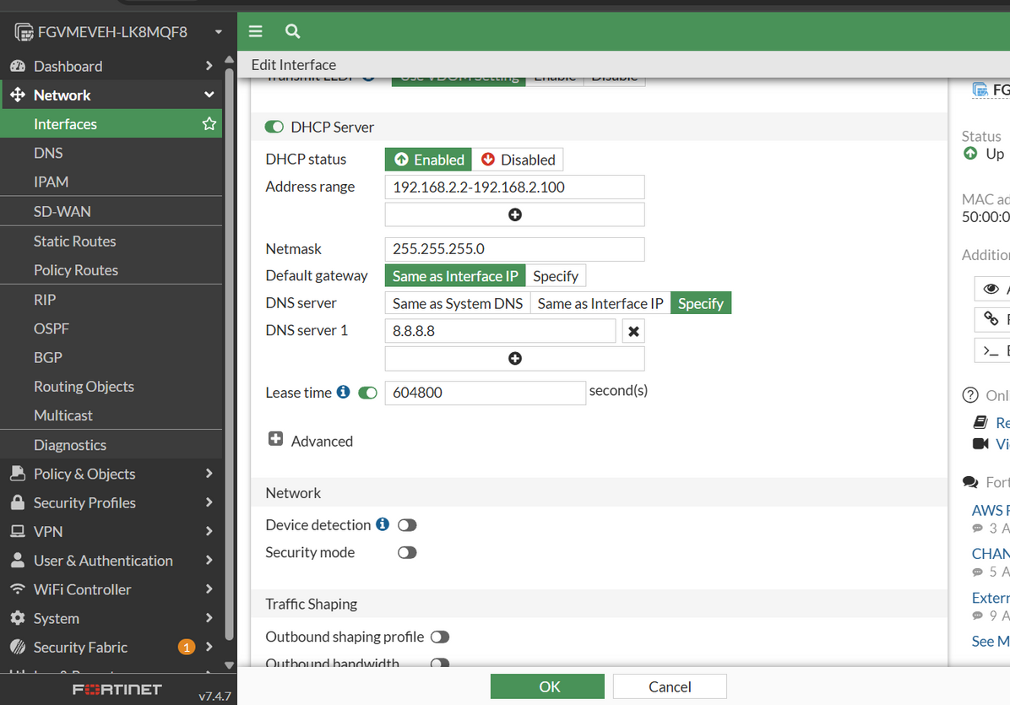
DHCP SERVER CONFIGURATION

Slide 9
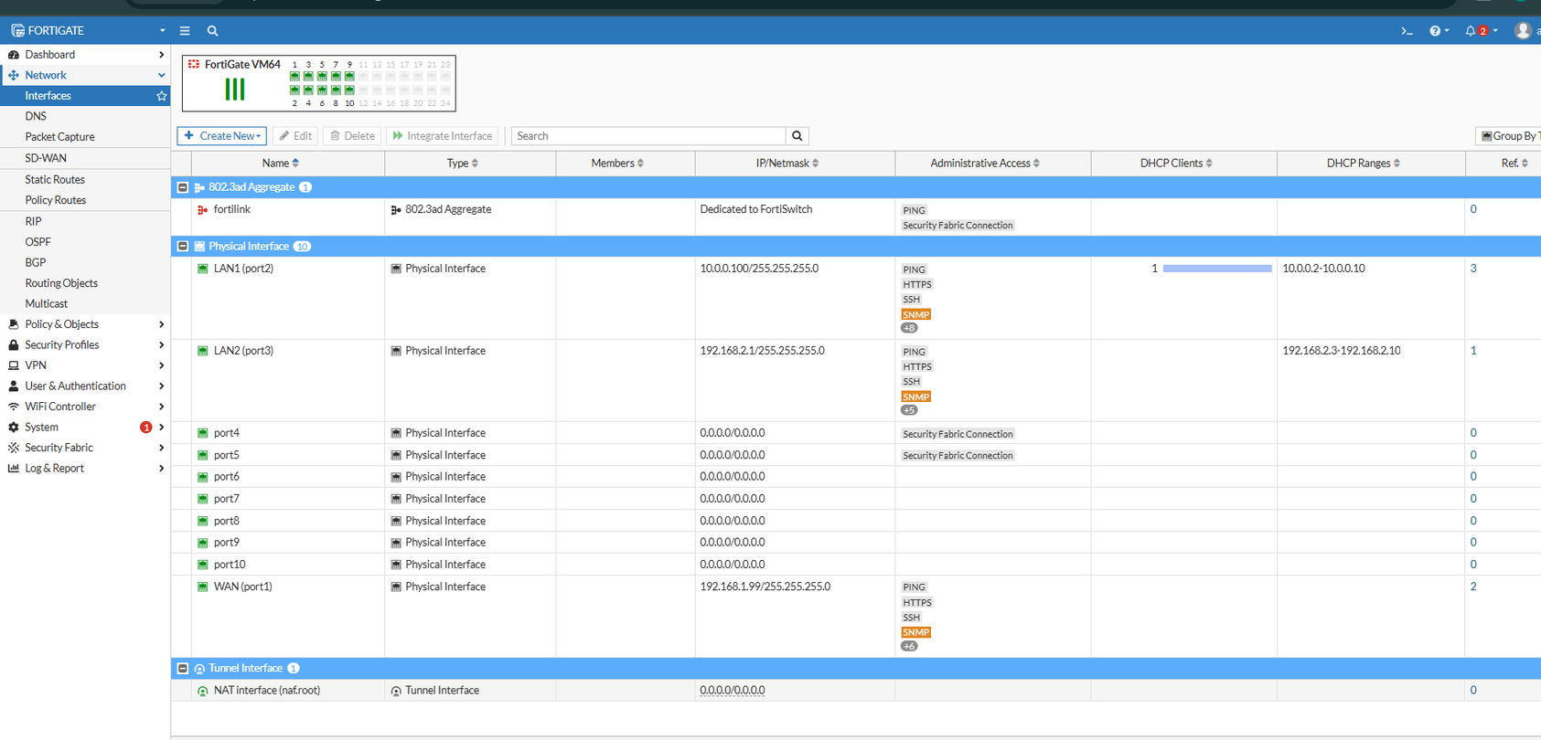
INTERFACES CONFIGURATION

Slide 10
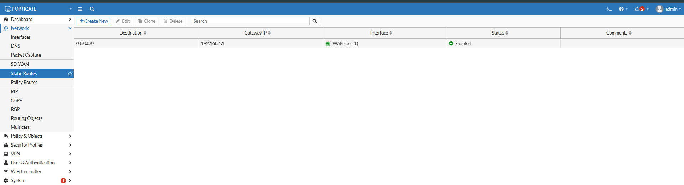
STATIC ROUTE

Slide 11
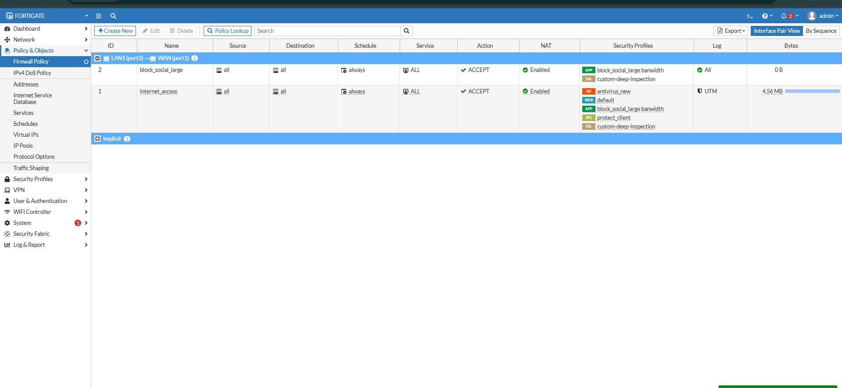

FIREWALL POLICIES

Slide 12
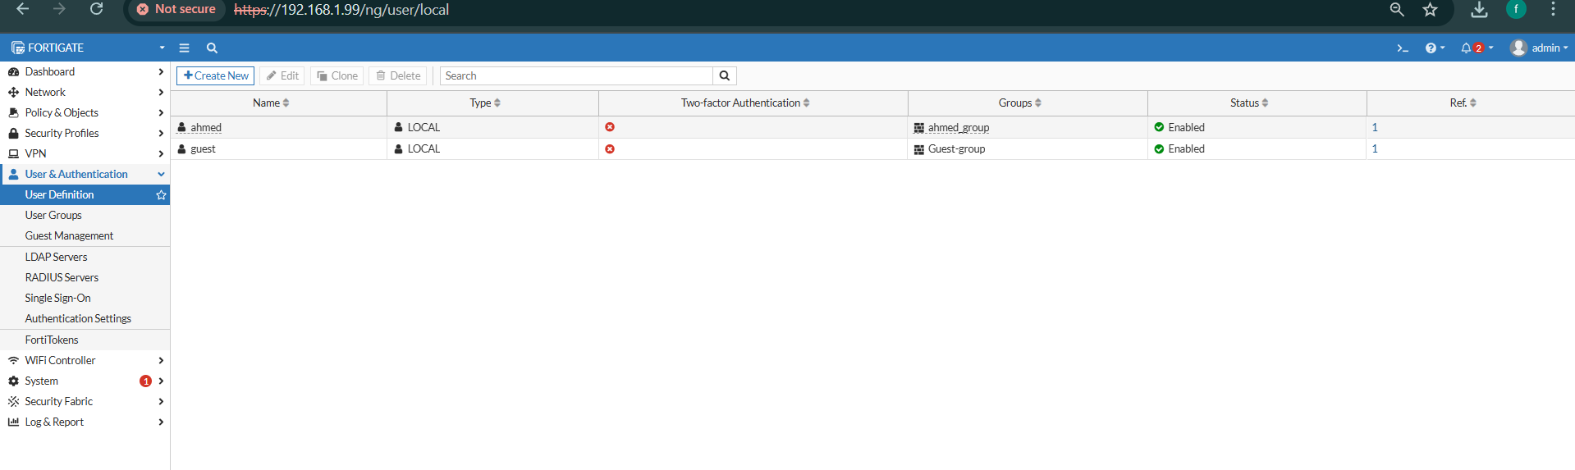
USER CONFIGURATION

Slide 13
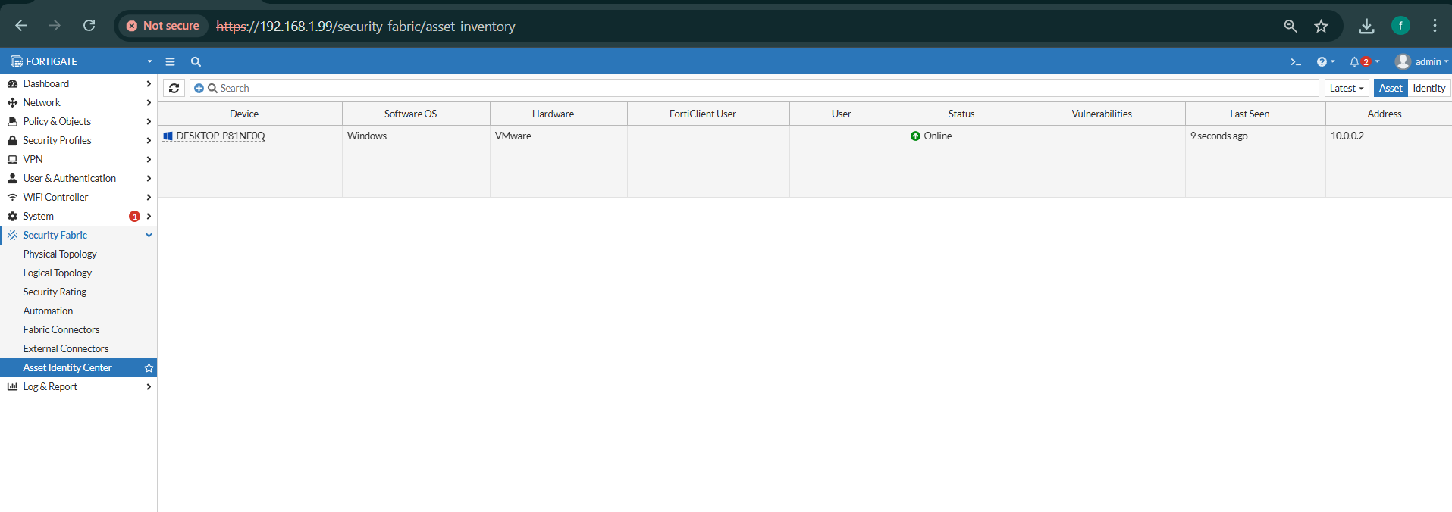
ASSET IDENTITY CENTER

Slide 14
SECURITY FABRIC & NAT SETUP
SECURITY FABRIC DASHBOARD: CONFIRMS ONE CONNECTED INTERNAL DEVICE
DHCP RANGE: 192.168.2.2 – 192.168.2.100 WITH DNS 8.8.8.8
BASIC NAT POLICY:
•ENABLES NAT USING THE outgoing WAN interface IP
•Preserves source port for consistent connections

Slide 15
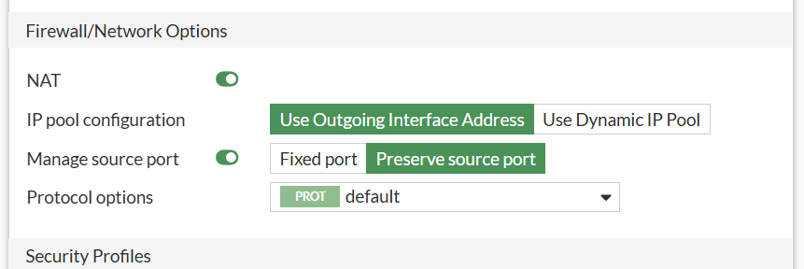
BASIC NAT POLICY

Slide 16
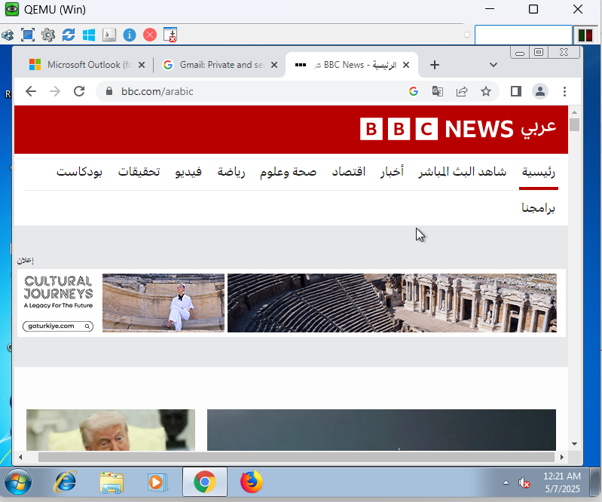
VERIFY INTERNET ACCESS AND SESSIONS

Slide 17
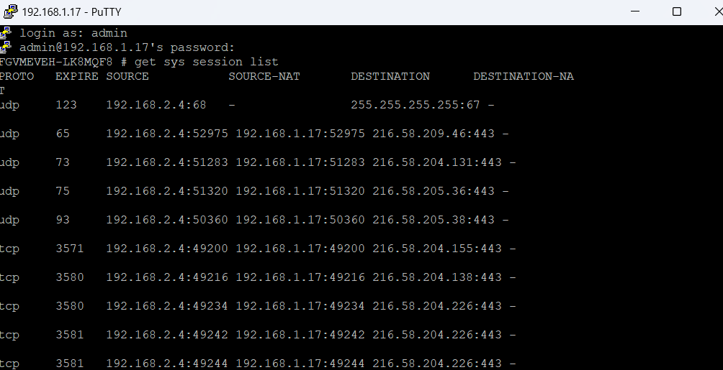
SHOWS NAT SESSIONS WORKING FROM INTERNAL IP (192.168.2.4) TO EXTERNAL IPS. THIS CONFIRMS TRAFFIC IS BEING NAT’D PROPERLY THROUGH FORTIGATE.

Slide 18
ADVANCED NAT: IP POOLS
DYNAMIC IP POOL (OVERLOAD):
•EXTERNAL IPS: 192.168.1.100–102
•SHARES PUBLIC IPS WITH INTERNAL DEVICES VIA PAT
FIXED PORT RANGE:
•EXTERNAL IPS: 192.168.1.200–201
•ASSIGNED only to internal IP 192.168.2.2 with 32 ports per user

Slide 19
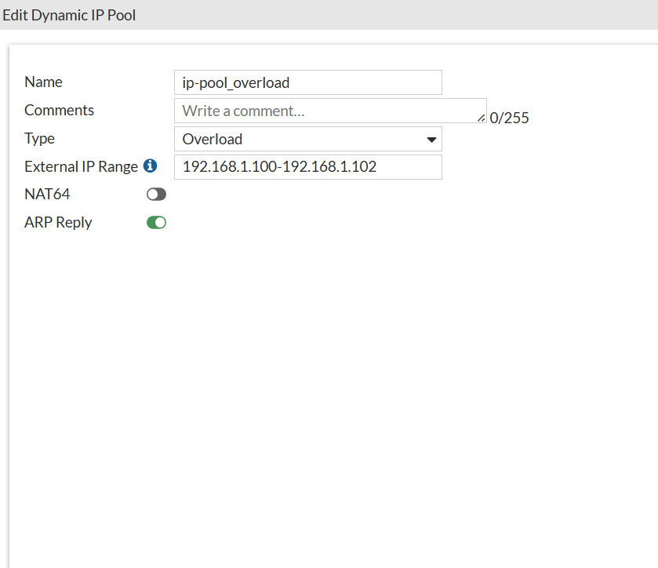
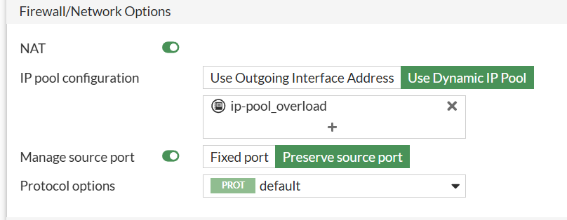
DYNAMIC IP POOL – OVERLOAD

Slide 20
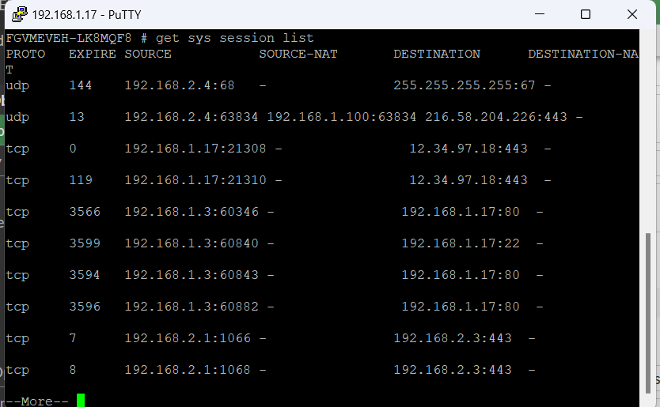
VERIFY SESSION WITH IP POOL

Slide 21
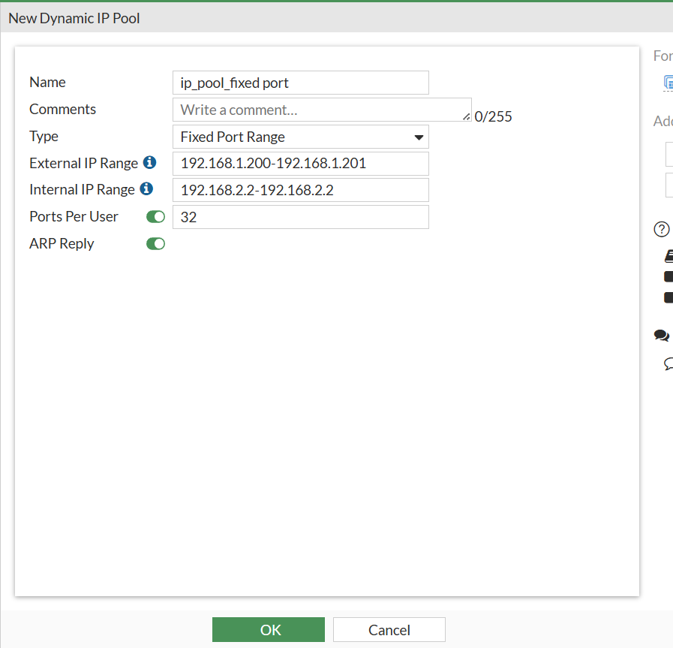
IP POOL – FIXED PORT RANGE

Slide 22
VERIFY SESSION WITH FIXED PORT RANGE

Slide 23
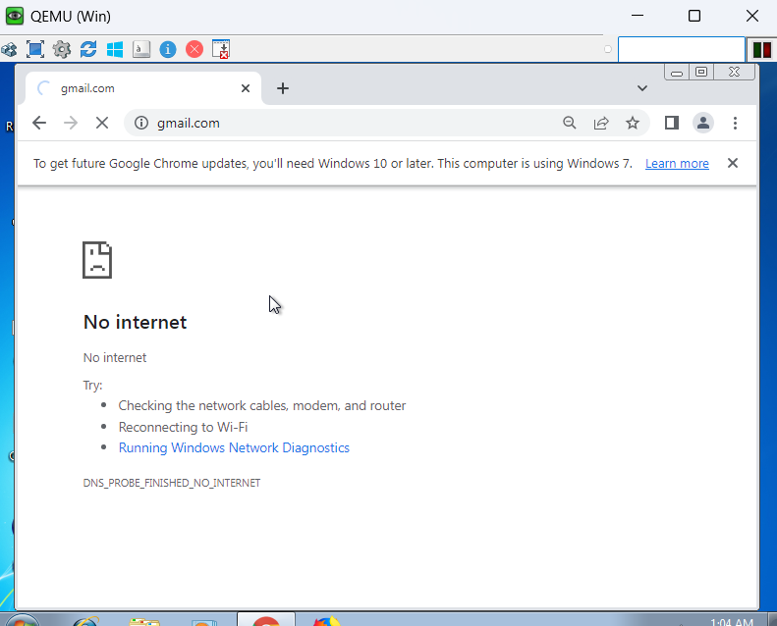
DEMONSTRATION OF MISCONFIGURATION OR IP MISMATCH

Slide 24
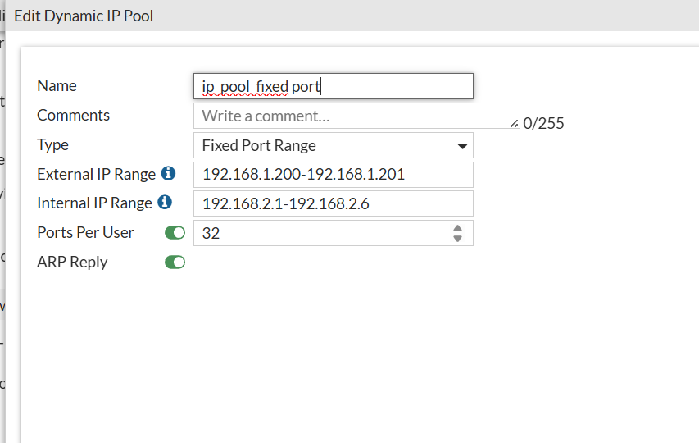
FIXED PORT RANGE IP POOL CONFIGURATION

Slide 25
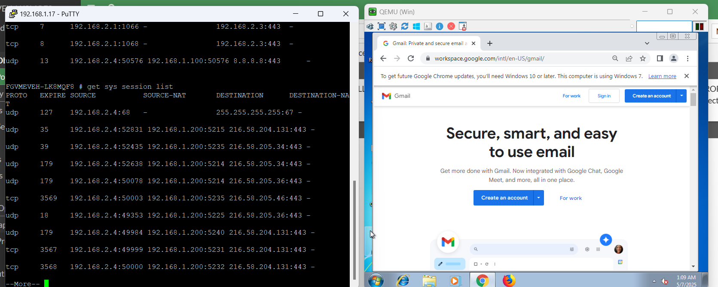
VERIFYING FIREWALL POLICY + NAT SUCCESS

Slide 26
CENTRAL NAT & DNAT
CENTRAL NAT ACTIVATION: ENABLED AFTER REMOVING IP POOL CONFLICTS
SNAT CONFIGURATION: ALLOWS LAN → WAN TRAFFIC USING WAN INTERFACE
DNAT WITH VIRTUAL IP:
•EXTERNAL IP: 192.168.1.101
•Internal Web Server: 192.168.2.15
•Allows WAN users to access internal services

Slide 27
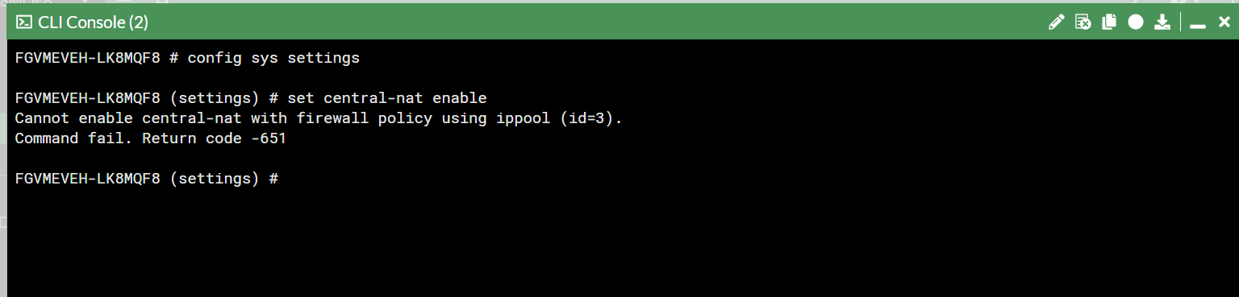
CENTRAL NAT SETUP

Slide 28
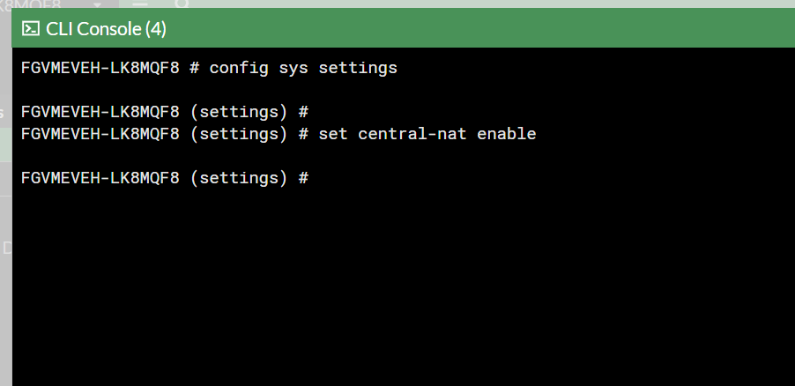
CENTRAL NAT ENABLED SUCCESSFULLY

Slide 29
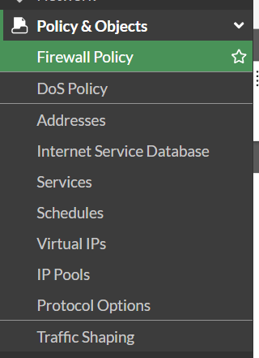
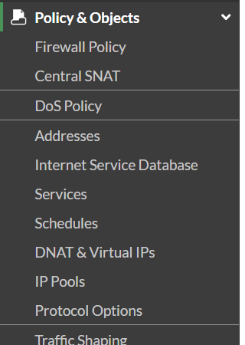
CREATING/EDITING POLICIES
BEFORE ENABLING CENTRAL NAT:
AFTER ENABLING CENTRAL NAT: SNAT ,DNAT APPEAR

Slide 30
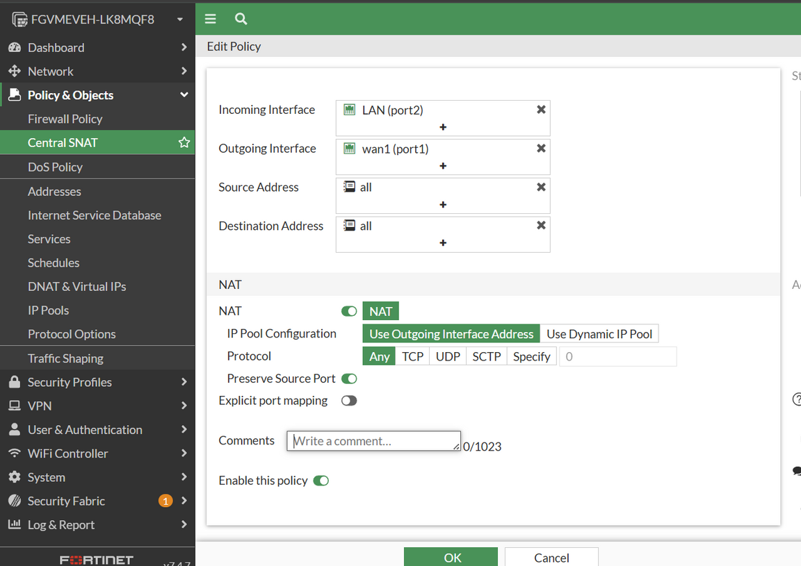
CONFIGURING CENTRAL SNAT

Slide 31
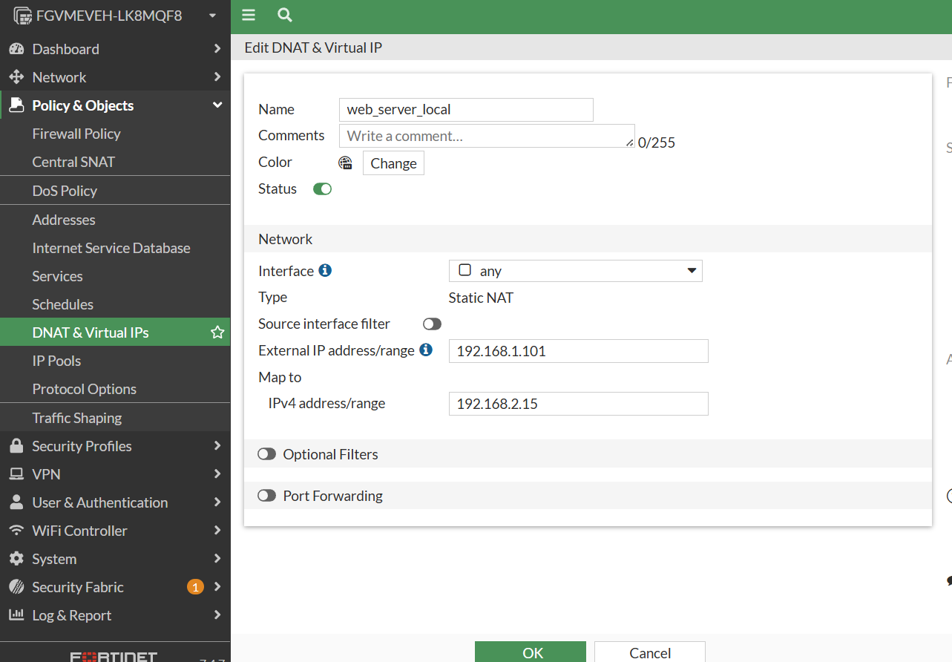
DNAT WITH VIRTUAL IP

Slide 32
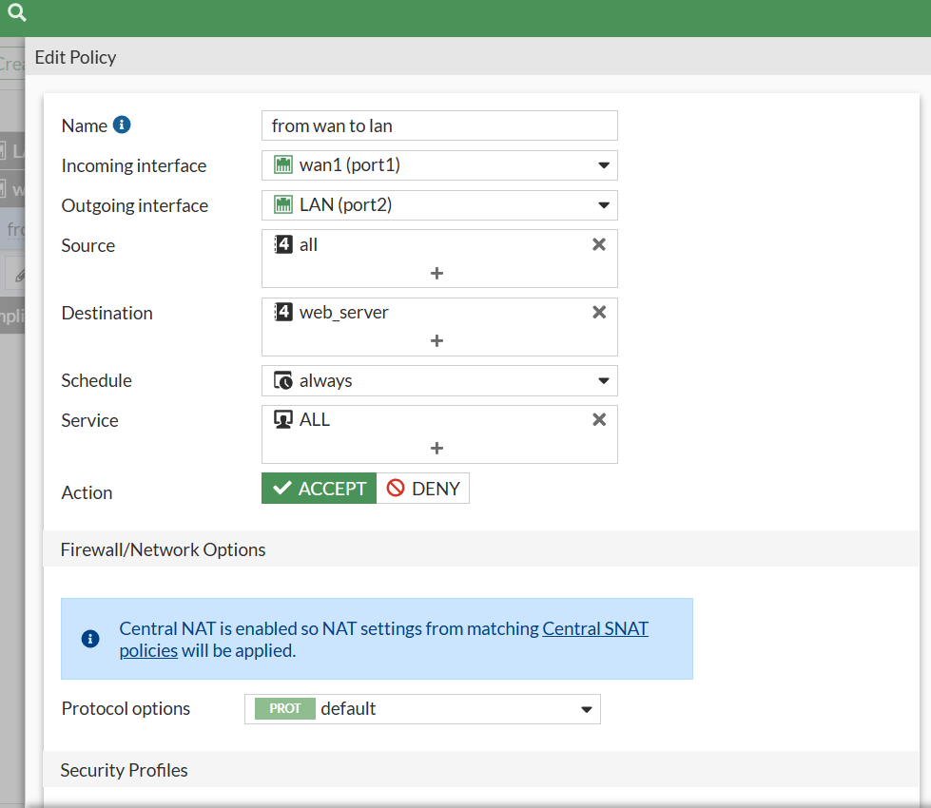
POLICY FOR ACCESSING INTERNAL SERVER (DNAT)

Slide 33
FIREWALL POLICIES & SSL INSPECTION
•LAN TO WAN POLICY:
•ALLOWS ALL TRAFFIC
•NAT ENABLED
•WEB FILTER, AV, APPLICATION COntrol applied
•SSL Deep Inspection:
•Full inspection mode
•Requires installing FortiGate CA certificate

Slide 34
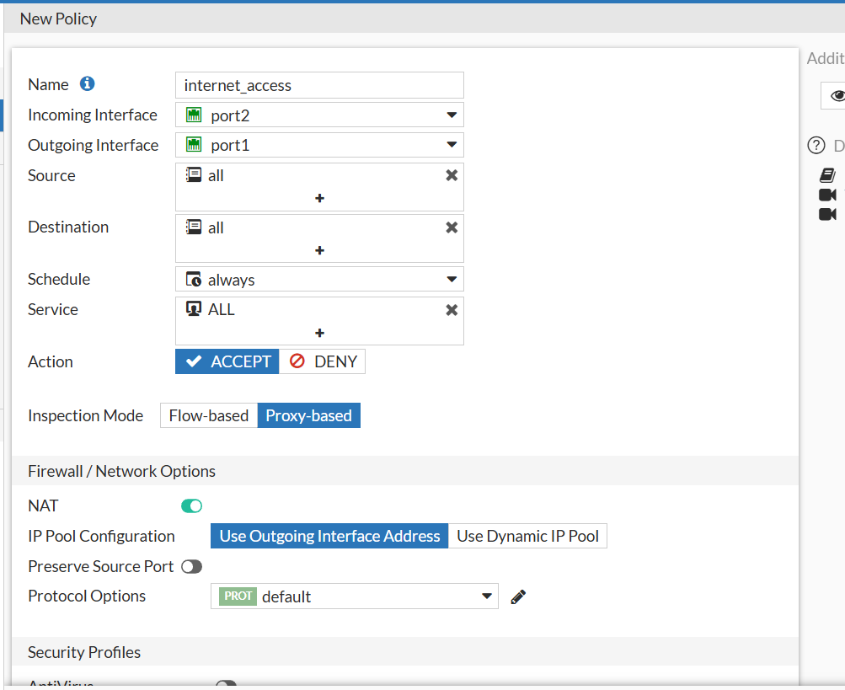
FIREWALL POLICY

Slide 35
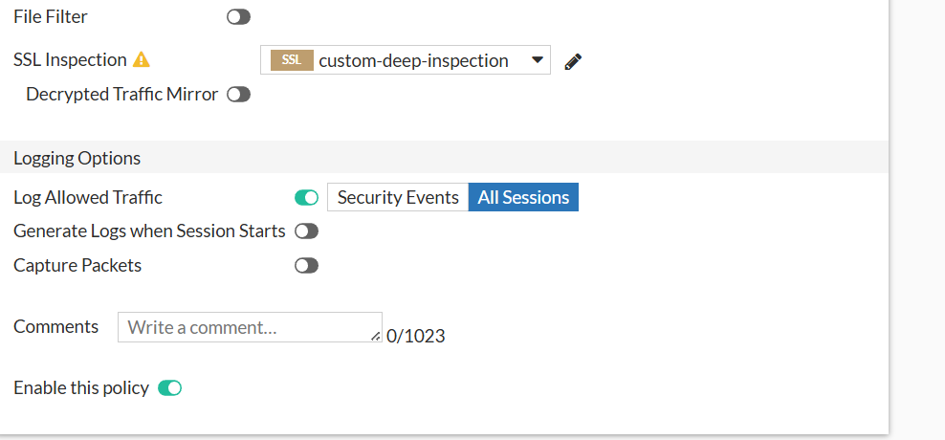
LOGGING & INSPECTION OPTIONS

Slide 36
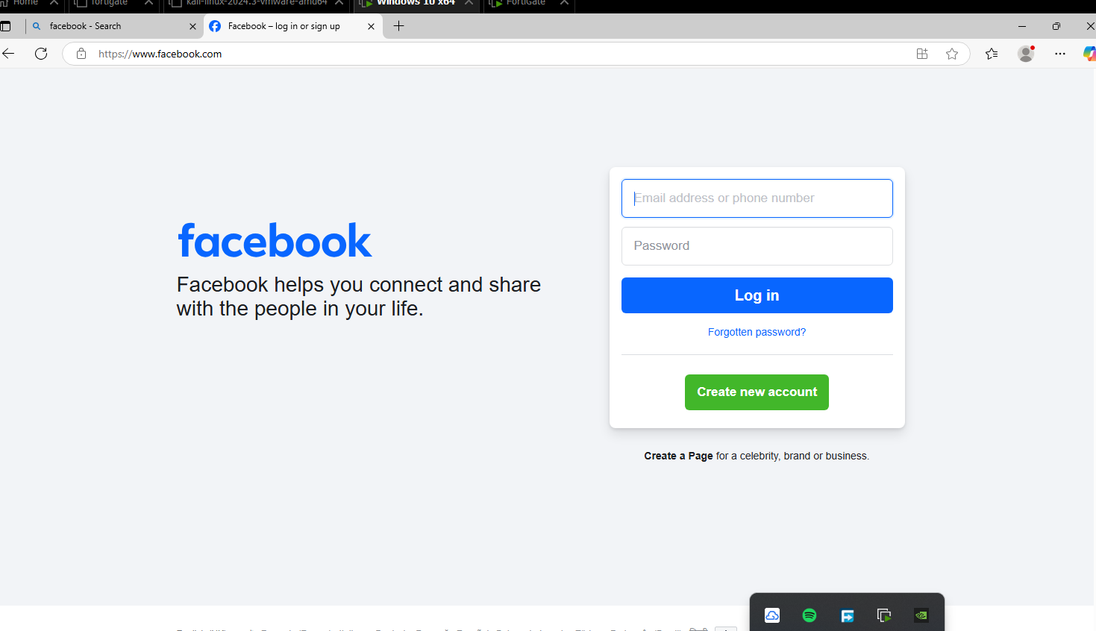
FACEBOOK ACCESS TEST

Slide 37
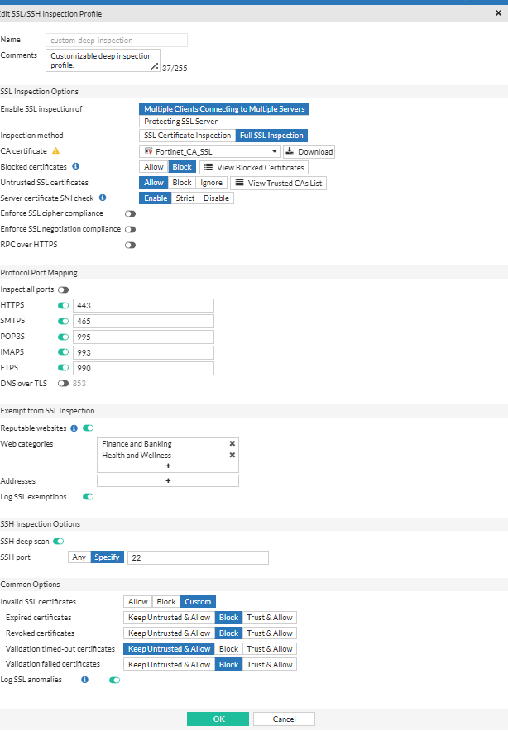
SSL INSPECTION PROFILE
AFTER DEEP INSPECTION

Slide 38
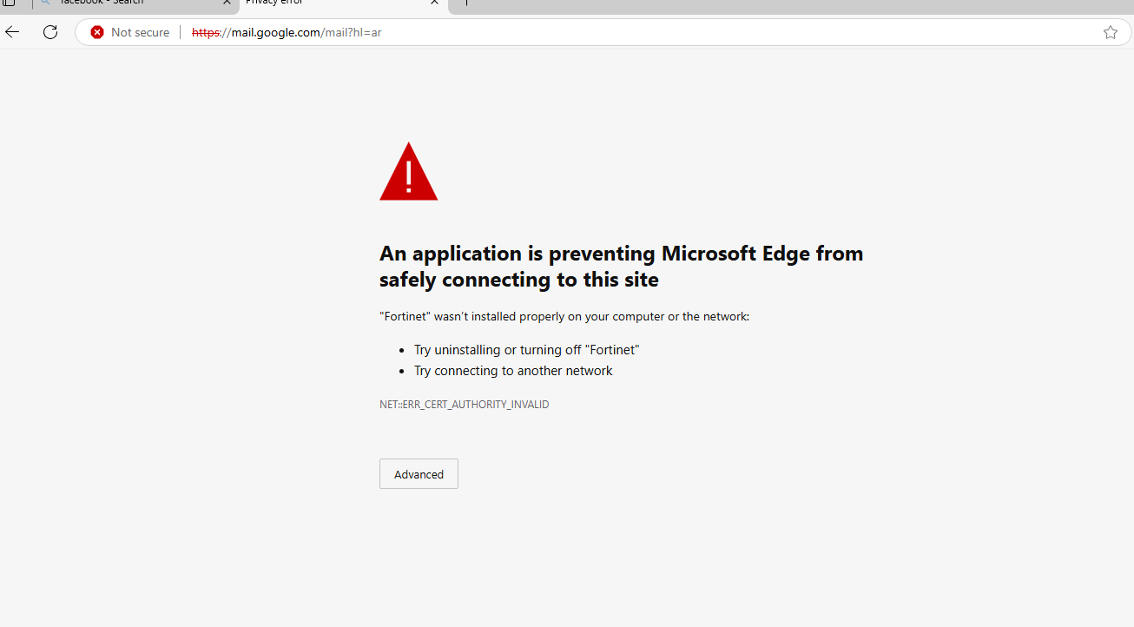
SSL CERTIFICATE ERROR PAGE

Slide 39
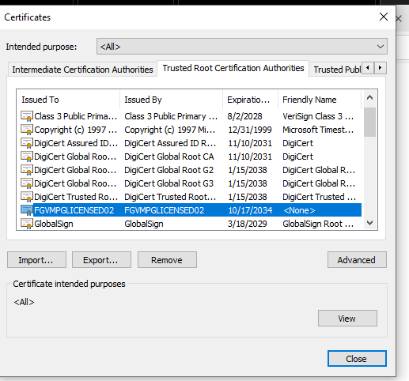
TRUSTED ROOT CERTIFICATE LIST

Slide 40
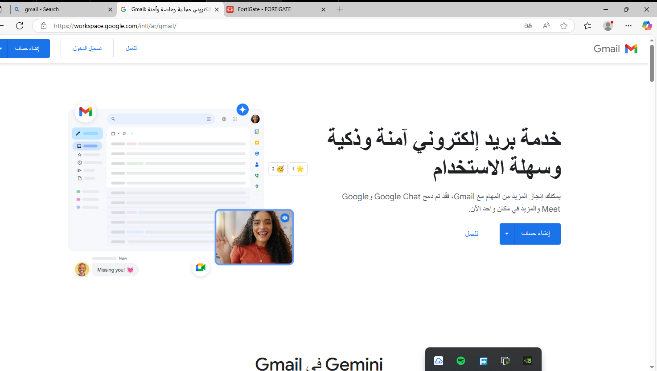
GMAIL ACCESS RESTORED

Slide 41
WEB FILTERING POLICIES
•CATEGORIES BLOCKED: JOB SEARCH, ADULT CONTENT, ALCOHOL, GUNS
•KEYWORD FILTER: BLOCKS terms like "cat", "weabons"
•Overrides: Prompt user login for access to restricted categories

Slide 42
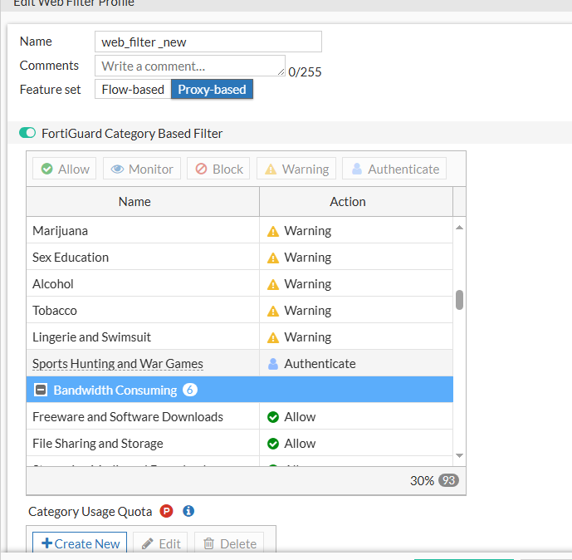
WEB FILTER PROFILE

Slide 43
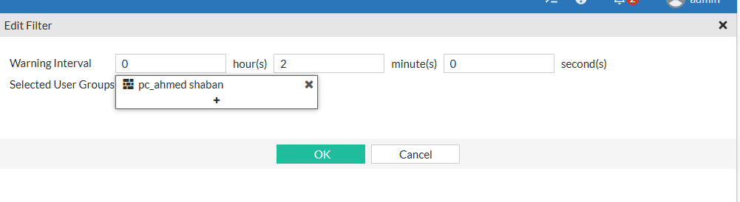
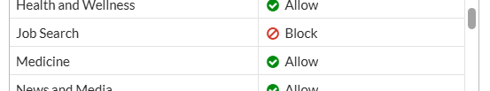
EDIT FILTER – WARNING INTERVAL
WEB FILTER CATEGORY – JOB SEARCH BLOCKED

Slide 44
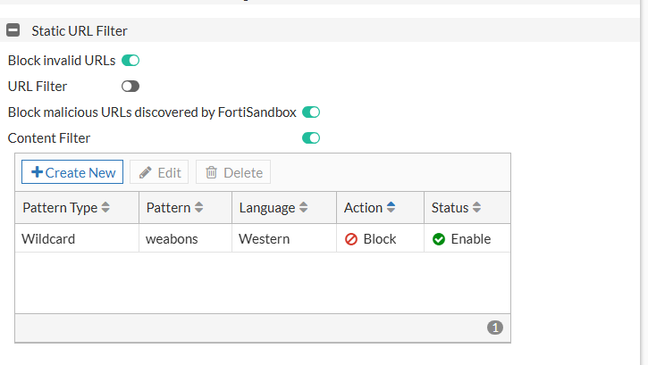
STATIC URL FILTER - SINGLE KEYWORD (WEABONS)

Slide 45
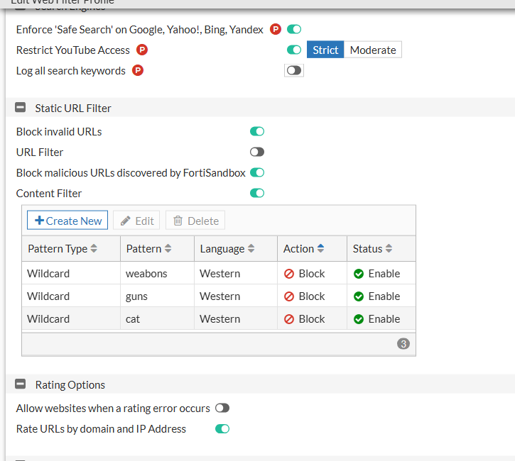
MULTIPLE STATIC FILTERS – WEABONS, GUNS, CAT

Slide 46
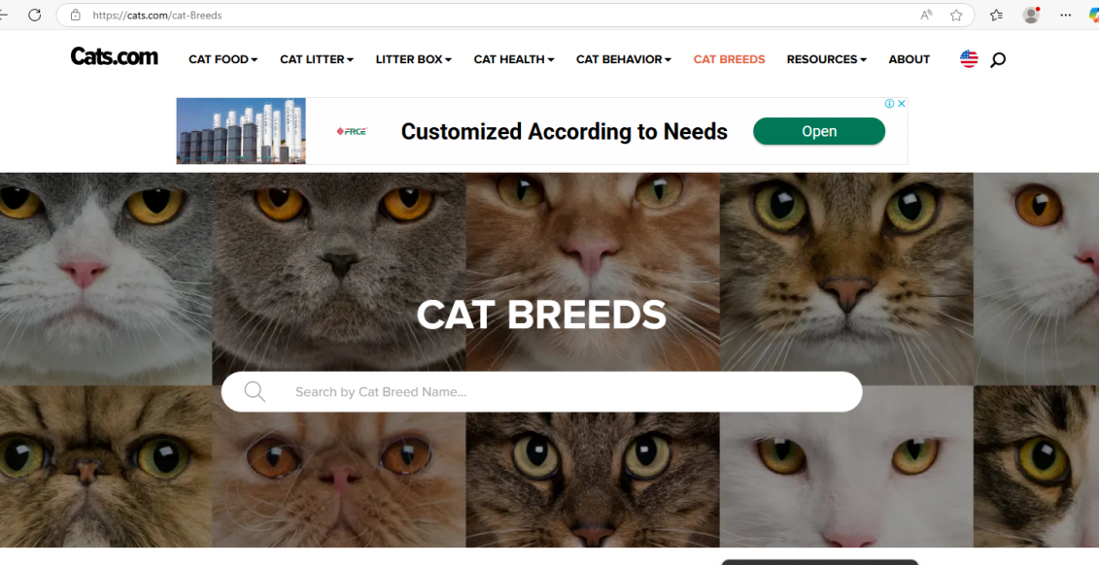
TEST RESULT – CAT WEBSITE ACCESSED

Slide 47
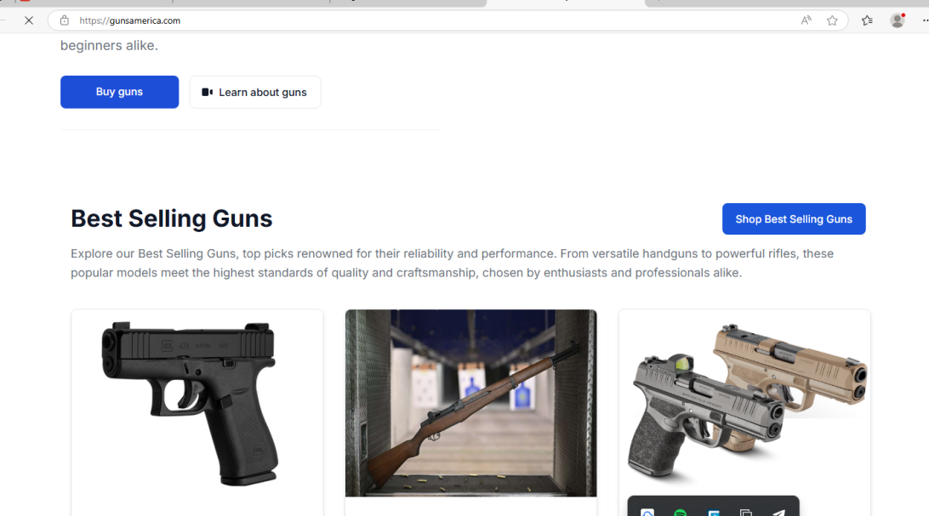
TEST RESULT – GUNS WEBSITE BLOCKED

Slide 48
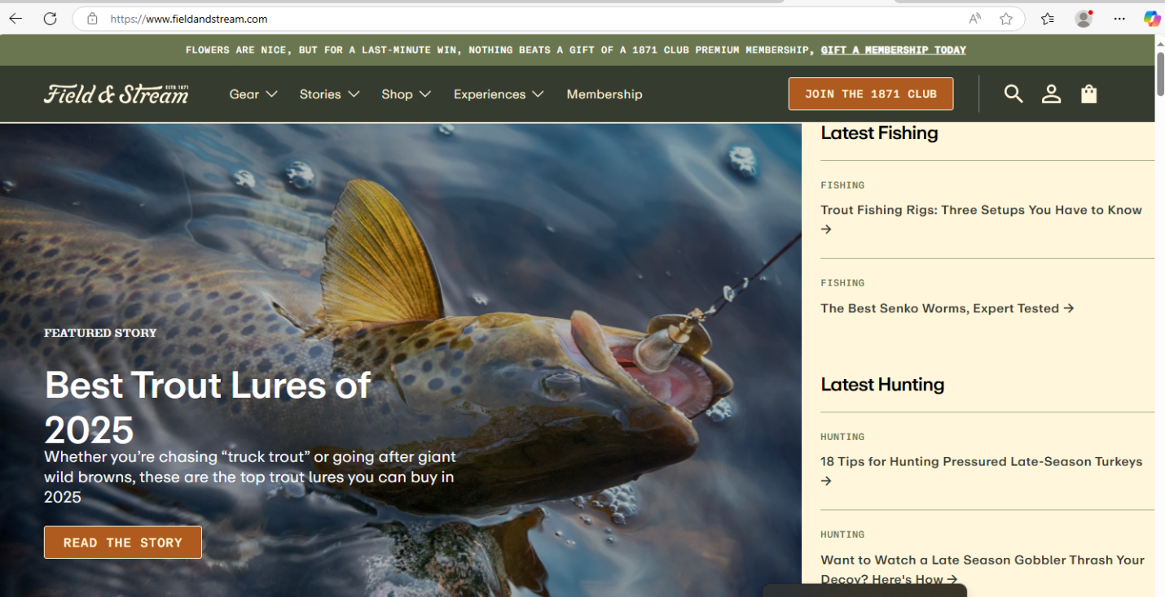
FISHING & HUNTING WEBSITE ACCESSED

Slide 49
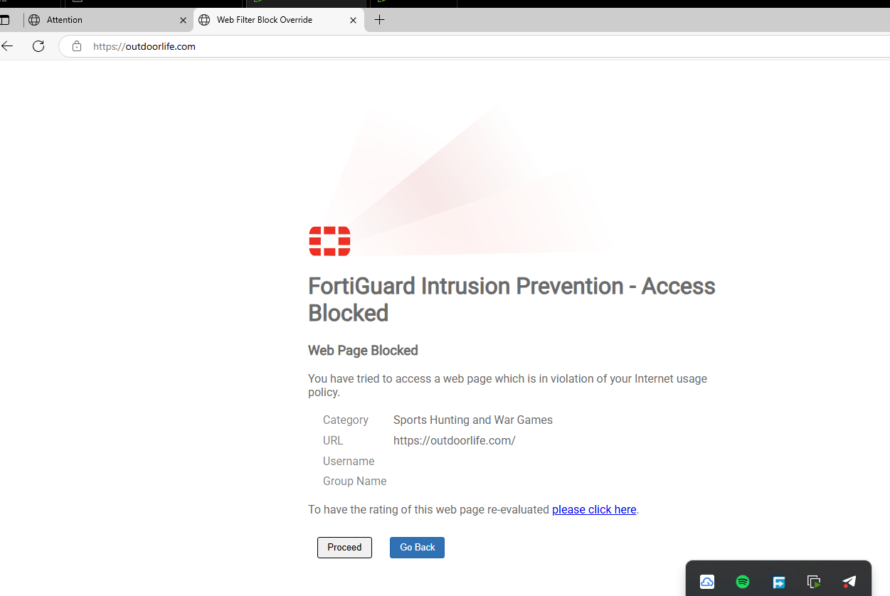
FORTIGUARD BLOCK PAGE – SPORTS HUNTING

Slide 50
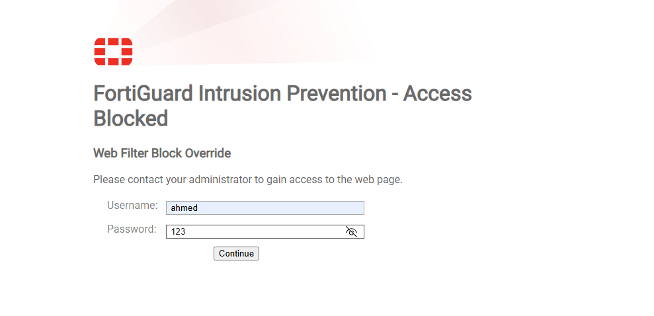
WEB FILTER OVERRIDE PROMPT

Slide 51
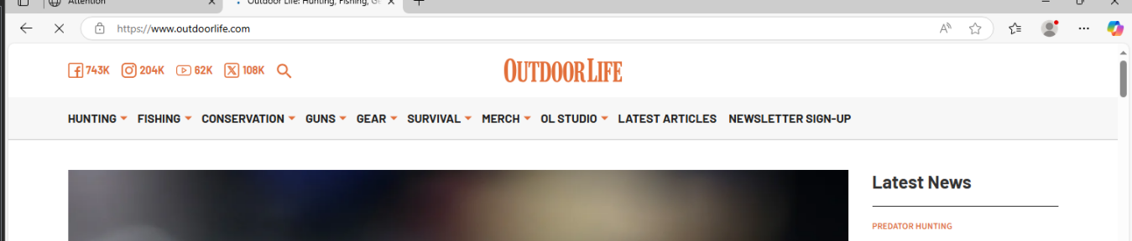
OUTDOORLIFE WEBSITE ACCESSED

Slide 52
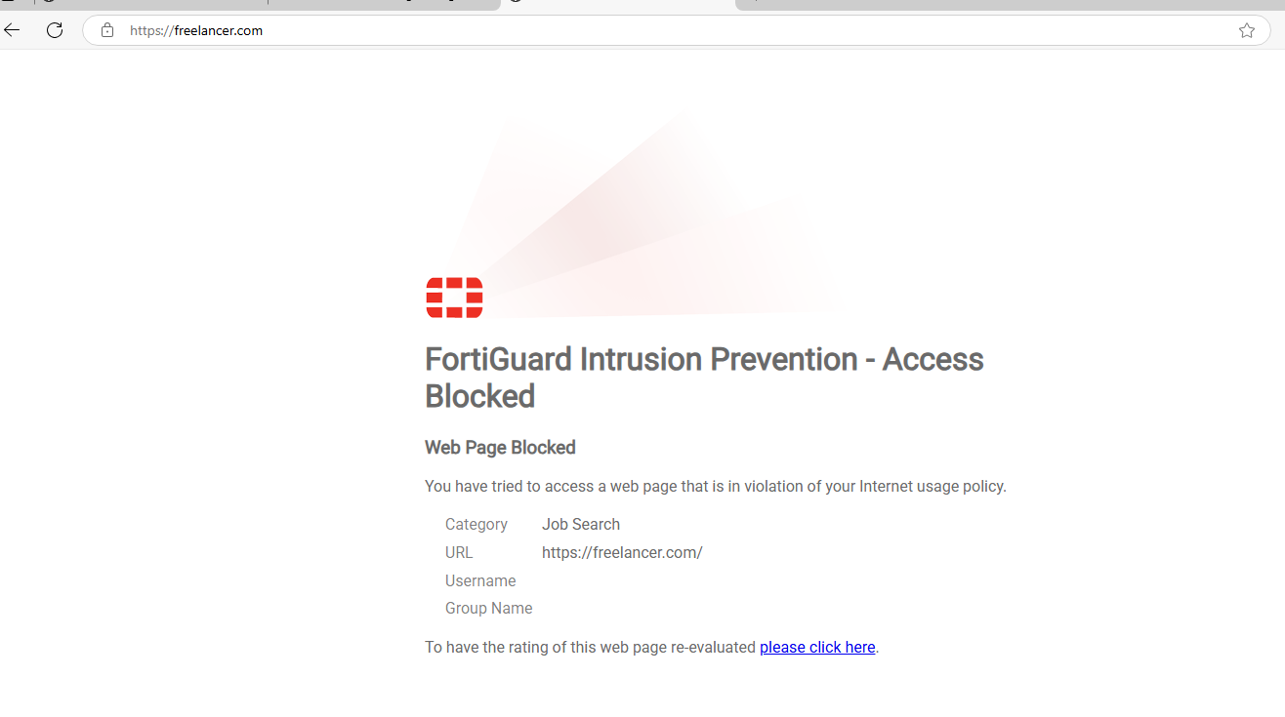
FREELANCER BLOCKED PAGE

Slide 53
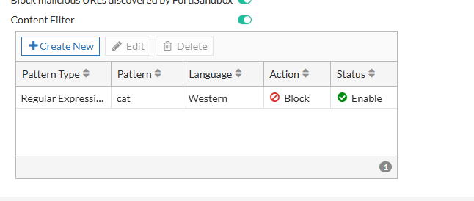
CONTENT FILTER

Slide 54
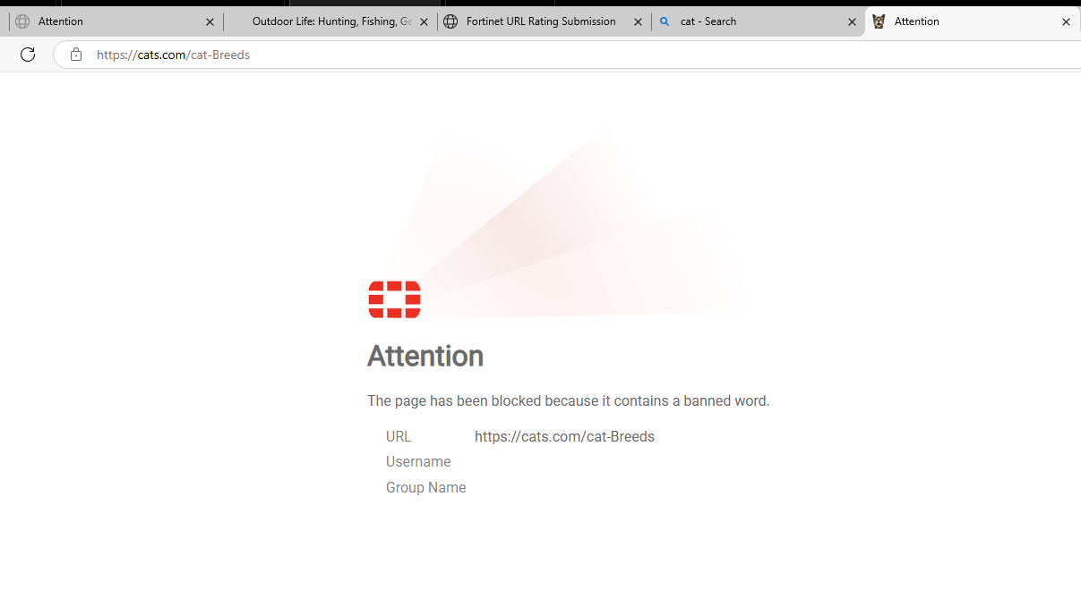
BLOCKED PAGE

Slide 55
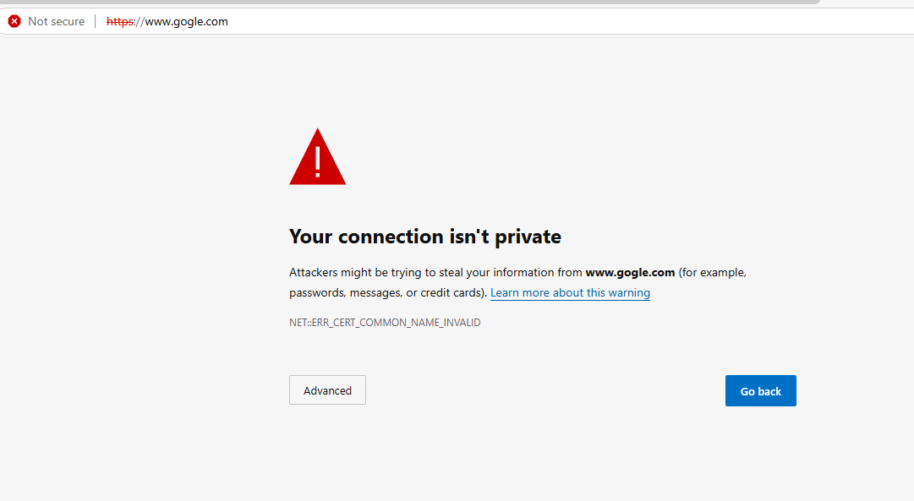
CERTIFICATE ERROR

Slide 56
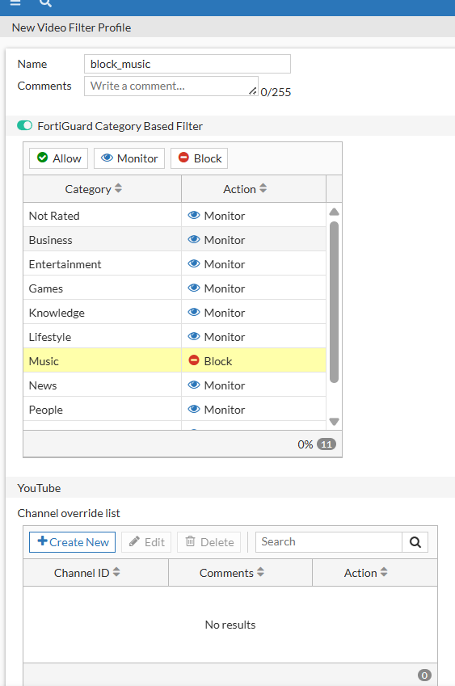
VIDEO FILTER – MUSIC BLOCK

Slide 57
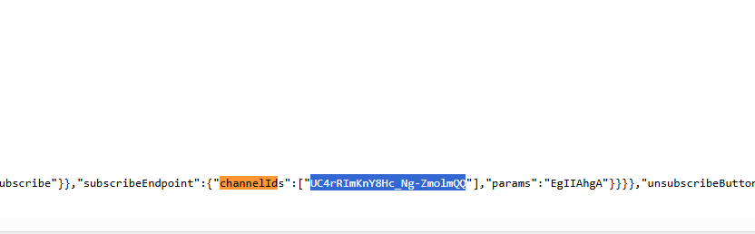
YOUTUBE CHANNEL ID IN SOURCE

Slide 58
ANTIVIRUS & IPS PROTECTION
•ANTIVIRUS PROFILE:
•BLOCKS HTTP, SMTP THREATS
•TESTED USING EICAR FILE → BLOCKED SUCCESSFULLY
•IPS PROFILE:
•BLOCKS KNOWN CVEs, client-side threats
•Tested with simulated large ICMP packet from Kali → 100% packet loss

Slide 59
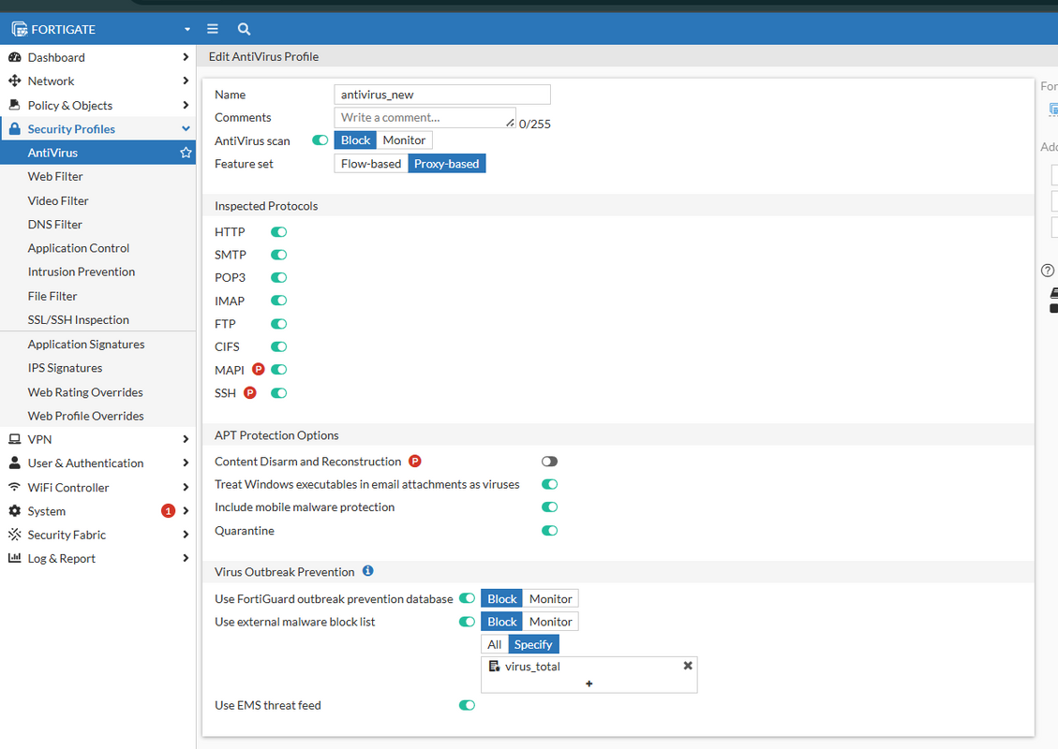
ANTIVIRUS PROFILE CONFIG

Slide 60
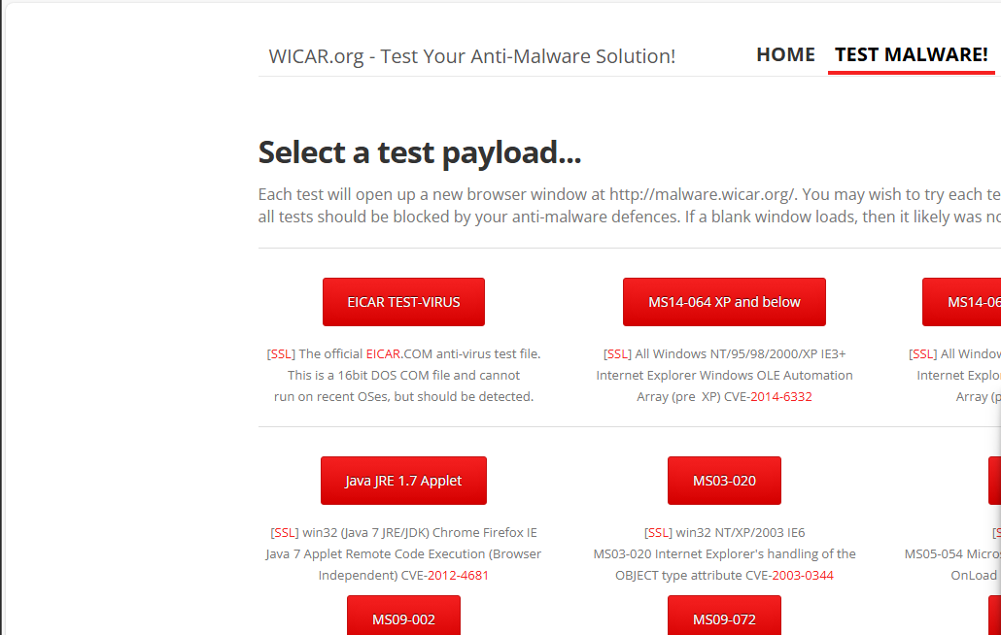
WICAR – MALWARE TESTING SITE

Slide 61
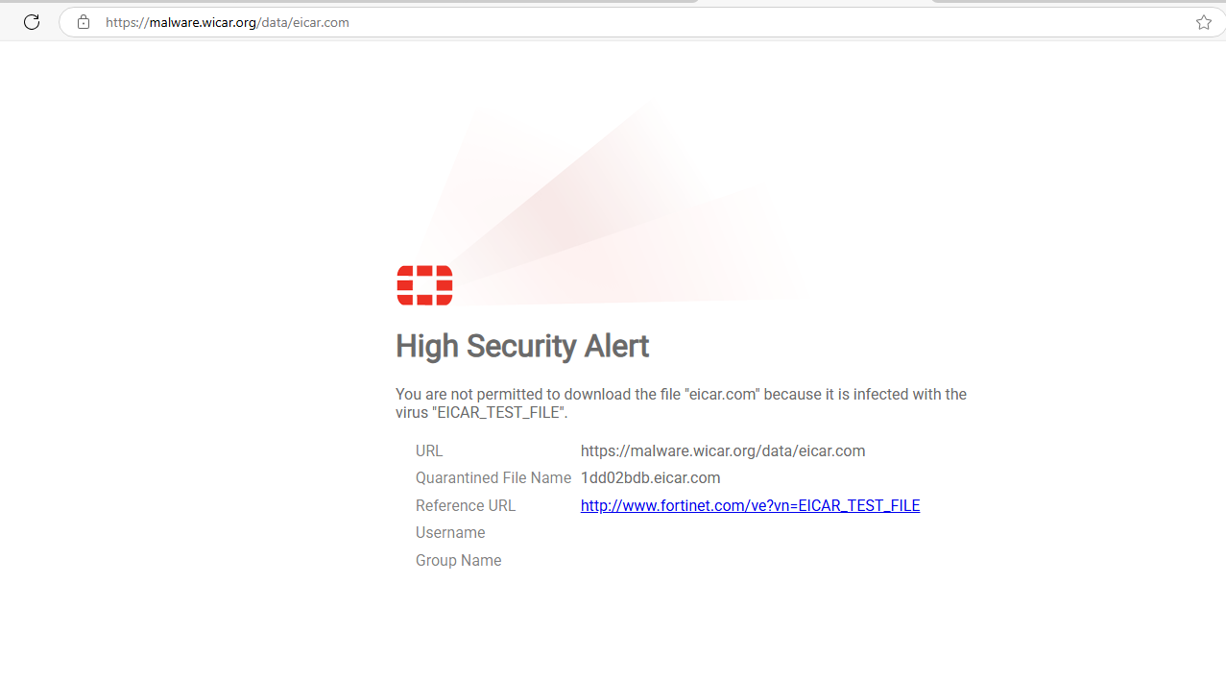
EICAR BLOCKED ALERT

Slide 62

AV LOG ENTRY FOR EICAR

Slide 63

IPS SIGNATURE FILTER CONFIGURATION

Slide 64

IPS SENSOR

Slide 65


PING ATTACK ATTEMPT (FROM KALI)
DEBUG LOG: IPS SESSION OUTPUT

Slide 66

ROUTING TABLE CHECK

Slide 67

FORWARD TRAFFIC LOGS

Slide 68
APPLICATION CONTROL & BANDWIDTH MANAGEMENT
BLOCKED APPS: FACEBOOK, YOUTUBE (EXCESSIVE BANDWIDTH)
MONITORED APPS: LINKEDIN (ACTIVITY TRACKED)
POLICY SETUP:
PROXY-BASED INSPECTION
CONTROLs access between LAN interfaces

Slide 69

APPLICATION CONTROL PROFILE

Slide 70

LINKEDIN APPLICATION OVERRIDE

Slide 71

FIREWALL POLICY (TEST_APPLICATION_CONTROL)

Slide 72

FACEBOOK BLOCKED (ERR_CONNECTION_CLOSED)

Slide 73

LINKEDIN VERIFICATION PAGE

Slide 74

YOUTUBE BUFFERING

Slide 75
FINAL TESTING
•ALL POLICIES VERIFIED USING:
•BROWSER TESTS (GMAIL, YOUTUBE, FACEBOOK)
•NAT SESSION LOGS
•FORTIGATE EVENT LOGS
•SSL INSPECTION WORKED AFTER CERTIFICATE INSTALL
•ANTIVIRUS & IPS BLOCKED THREATS AS EXPECTED
•APPLICATION CONTROL filtered social & high-bandwidth traffic

Slide 76
CONCLUSION
FORTIGATE WAS SUCCESSFULLY CONFIGURED FROM BASIC TO ADVANCED LEVEL, PROVIDING STRONG CONTROL and protection for internal networks.

Slide 77

DEPI
THANK YOU
GRADUATION PROJECT

